Slide 1
ScRNAseq in the Cloud: Pipelines to Insights 2024
Nextflow Introduction

Slide 2



Workflows
Using computers to collect, store, analyze, and disseminate data and information
Large files
Many languages
Complex interactions
> 100 GB for one raw human genome…
Bash, Python, R, PERL…
Networks of software and their dependencies…
Notes:
In the context of the work a bioinformatician or data analyst may conduct, it is the process of ….
And these workflows may utilize super large files that take forever to download and yet begin to process
Additionally the process or function or tool you may use to parse the data may span across many different languages, ….. just being some of them
These workflows may also be non-linear an have many branches, merge points, and loads of output files, on top of that we as the programmers are expected to track and maintain everything that is happening under the hood for diligent reporting.
This costs a ton of added time and effort to effectively manage or tackle each of these problems. To overcome these our core and many others around the world have begun to embed our workflow management using a programming language called NEXTFLOW!

Slide 3



Nextflow
Nextflow is a language, a runtime, and a community
Reproducible
Portable
Scalable
Integration with code management tools, with versioned releases.
Docker, Singularity, Conda, works with most compute environments.
5 samples on your laptop, 5k on an HPC or
5 million in the cloud.
Notes:
Ill talk a little further on what each of those points mean soon.
But Nextflow is categorized as a Domain Specific Language, which really just means it aims to provide a solution to some problems that the industry currently faces with best programming practices.
As a whole Nextflow allows users, and programmers to run and write pipelines to carry out some sort of data analysis in ways that are highly reproducible, meaning anyone should be able to reproduce the work you generated from a nextflow pipeline, highly portable, so that tools may be re-used and plugged or placed in any analysis where applicable ( Joel told us a “joke” one time that went something like “why did the developer write their own alignment quantification tool? … because the 1000 existing ones juuuuuussssst didn’t have that one feature that they were looking for….” ). But this is a real issue within the current landscape of bioinformatics, there are 10+ tools that exists that all aim to solve the same problem. With nextflow (and the community built behind it) there is much less redundancy and each published tool is designed in a way that they can be used on any data type they accept plus the flexibility of any additional parameters.
Furthermore, nextflow pipelines are extremely scalable as long as you have the necessary compute resources available to run each of the tools designated within a pipeline.

Slide 4

Reproducibility
Hidden reproducibility issues are like an iceberg
First, we tried to re-run the
analysis with the code and data provided by the authors.
Second, we rewrote the whole
method in a Python package...
Experimenting with reproducibility:
a case study of robustness in bioinformatics
Kim et al., GigaScience (2018).
https://doi.org/10.1093/gigascience/giy077
Notes:
Only a small piece of the larger problem is displayed to the viewer. The majority of the problem lies beneath what is immediately obvious.
I don’t know if many of you are familiar with what is known as a programs dependency, but in simple terms they are software packages that a tool may call upon for a function or data structure that helps the tool operate. And each dependency can have numerous iterations or versions that may very slightly but affect the overall output from the program. These minor details are often overlooked and tend to be that portion of the iceberg that isn’t in plain sight but is vast and contributes greatly to the makeup as a whole.

Slide 5


















Nextflow
Nextflow is a language, a runtime, and a community
Write code
in any language
pipeline
Orchestrate tasks with
dataflow programming
Define software dependencies via containers
Built-in version control with Git
Task orchestration and execution
runtime
Notes:
To get back to this idea of Nextflow being a language, a runtime and community, I really want to stress that you do not need to know python, R bash, or any of these other programming languages to read, use, or even write a nextflow pipeline.
Most simply nextflow is a task orchestrator that operates using dataflow programming ( so we are orchestrating or managing how the data moves through a series of tools, but we aren’t necessarily making many changes to the data directly when we design a pipeline )
And to bring it back to portability, the reason we can plug and paste these tools into our pipelines with no additional software alignments or dependency debugging is by using software management services such as docker, singularity, and conda. These services take everything needed to run a program, app, or tool and bundles it all up into a stable function unit called a container ( shipping container analogy ).
There is also built in version control so that each iteration of a pipeline is captured incase you need or want to use a past version or the most recent.
And lastly nextflow is a run time and what that means is that the launching of jobs and tasks within a designed compute environment (whether aws’s infrastructure, google, microsoft azure, or even integration with a slurm manager on your own local cluster) each one of those platforms has already been integrated within nextflows functionality so there's no need to migrate from where you currently access your compute resources.

Slide 6
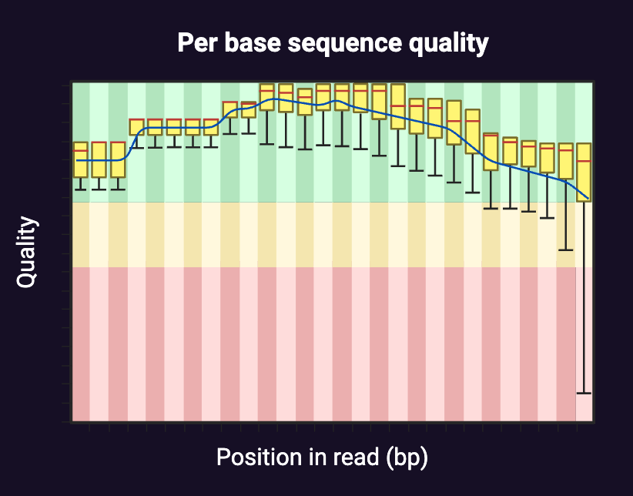

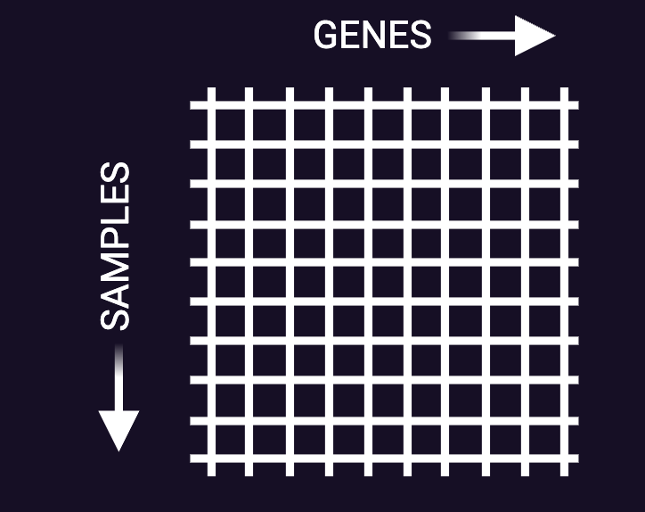






Nextflow
Nextflow is a language, a runtime, and a community
RESULTS
TOOLS
Configs
PIPELINE
Notes:
As a brief graphical example, we take a look at our common bioinformatician, who receives sequencing data
Learns about a tool for sequence quality control such as FASTQC, with this learning the bioinformatician needs to read the dense documents to identify applicable parameters, functionality, etc. they then should document everything they have learned about the tool, record additional files used, versions of the tool, versions of those pesky dependencies, and I’m sure I’m not covering everything. But in the end they produce a plot that conveys some interpretation of the data.
They then take this output data and move to the next tool (maybe it’s star and they are going to align the data), repeat this same documentation process, then move on to the next tool.
That 3 step process, which is not that many processes in the grand-scheme of what these pipelines can be constructed of, consumes tons of time and not to mention bandwidth to track all the information from each run, and keep track of samples, output files, etc. things can get very messy very quick.
What nextlfow and community provides are basically wrappers to consolidate and automate this process to expedite the analysis timeline and ultimately make the process easier for the end user.

Slide 7
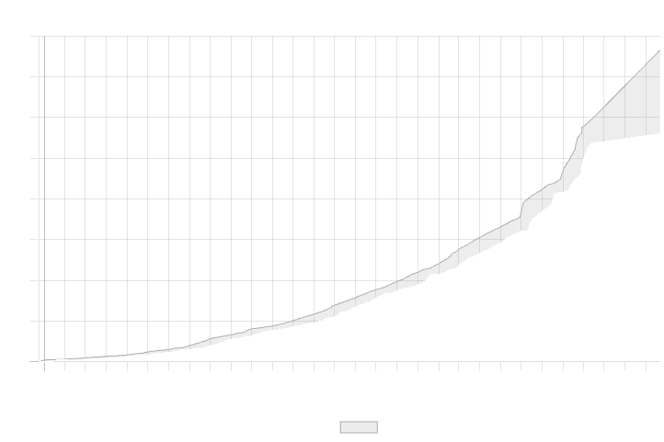
nf-core
A community effort to collect a curated set of analysis pipelines built using Nextflow
12k+
2k+
120+
Slack
users
GitHub
contributors
Pipelines
40k
16k+
7k+
GitHub
commits
Pull
requests
GitHub
issues
Notes:
To speak a little further on the community aspect of nextflow, there is a well established group of people from all over world that on the daily are contributing to nextflows ideology. This community is known as nf-core ….

Slide 8






Cooperation
nf-core principles
Principles that guide the nf-core community
Standards
Collaboration
Develop with the community
Use a common template
No duplicate pipelines within nf-core
Helper Tools
Compatibility
Components
Tools built for everyone
Tools work for any Nextflow pipeline
Collaborate on component-level
Notes:
There are a certain set of standards or principles that have been adopted by the community to preserve the goal that nextflow aims to achieve.
Cooperation, again communication is key so no service or tool is repeated numerous times within the industry.
Standardized code format, for developers to easily start a project and contribute to others, each pipeline comes with a pre-built boilerplate that serves as a starting point for each project. This makes it much easier to review these projects and ensures that best-practices are upheld.
Collaboration, which again plays into the same idea as cooperation.
Compatibility, again pushing home this idea of portability so that any tool can be inserted at any point or used by anyone, agnostic of their use-case.
Lastly, components, we will touch on this idea of modularization further in a bit, but nf-core really aims at developing tools at their smallest-function unit and configuring how that tool will interface with the computer architecture, input data-type, and ultimately deploy the underlying algorithm.

Slide 9






Pipelines
nf-core components
Pick and choose which component you need
Subworkflows
Modules
>95 pipelines and a base template
>55 subworkflows
>1150 modules
Linting
Schema
Tooling
Choose conventions to test for consistency
Validation, channels and user interface
Development and deployment
Notes:
Can be widely applied to all users, ranging from someone in the developer category that might want to utilize developer tools such as pipeline linting or schema architectures, or a PI, Research Assistant, Post-Doc can search and execute a pipeline, smaller subworkflow or even just run a functional module or tool in a easily deployable and documented fashion.

Slide 10
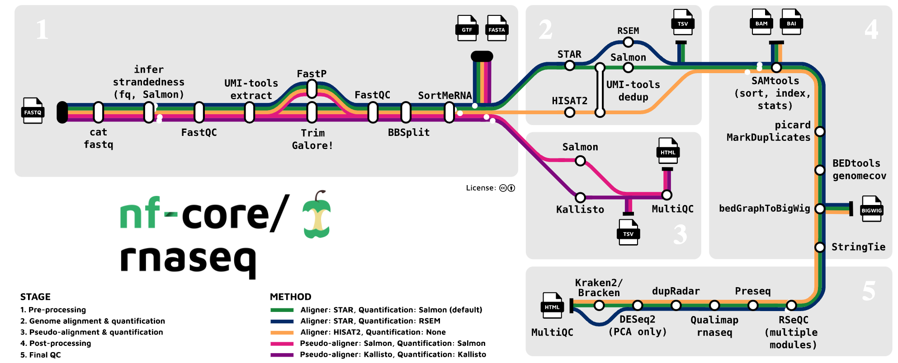
Nextflow
Managing modern workflows is complicated

Slide 11
Nextflow
A reactive workflow framework and a programming DSL
Parallelism
Reentrancy
(Resume partial runs)
Reproducibility
Notes:
Domain Specific Language - a language that is designed to tackle a specific set of problems rather than a more generally applicable language.
Parallelism, the idea of running multiple jobs or workflows simultaneously across many compute environments.
Re-entrancy, which allows a job or series of tasks to be resumed up to their most progressed point in a given run, allows for the flexibility of the pipelines so there is a failsafe (just because nothing that is automated is ever perfect).
Reproducibility, which enables all users of the pipelines to autonomously document all aspect of their run for cases in which results may need to be reproduced.

Slide 12



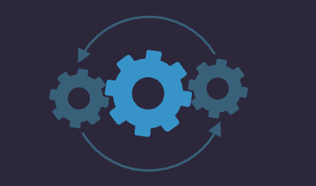




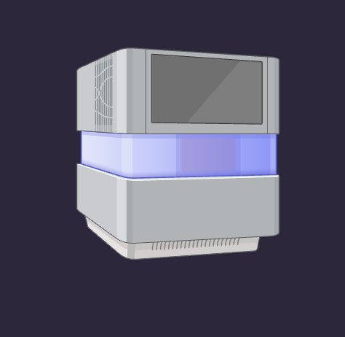

Nextflow
Use Case Studies - Reproducibility
Notes:
We start with a scenario displayed using our actors Ashley and Markus. Ashley is an ambitious PI that works very closely with her bioinformatician Markus. Ashley designs an experiment for RNA sequencing and sends her samples out to a third-party to produce her sequencing data. The company gets back to Ashley with the data and it is safe, secure, and high quality. - Mention that the data at this point is in its raw state, and there have been many steps taken to ensure there is redundancy and data fidelity. This is key to ensure we have a safety measure on something that was, expensive and took a lot of time and effort to produce.
So now that Ashley has her data she sends it to Markus and communicates with him a series of questions she has for the data set. **Maybe she is interested in the effect between some variables she controlled for, or is interested in the progression of a certain cell type/pathway within her organisms model**. Markus is a highly skilled bioinformatician and has worked within the industry for years, so he does what he has always done and sourced all of his knowledge to identify the tools he needs to use to answer Ashley’s questions. This is second nature for Markus, he spends a little time setting up the tools, he runs his analysis, and finally reports back to Ashley. And voila! they were able to produce a publication from their findings and Markus’s.
This is fantastic, but unfortunately, often times when operating on data analysis projects such as these, the web of functional units becomes too complex and dense to capture every manual decision, software, or underlying dependence used in the workflow (even for the most skilled and organized programmers or scientist’s). The redundancy and fidelity of the data at this step in the project is hanging on by a mere thread. Which when counting the operational hours used to produce the analysis, it’s probably a comparable cost to the generation of the raw data in the first stage. So one would think we would treat the processed data with a comparable integrity to the handling of our raw data.
So Markus does such a great job on this project he ends up attracting attention from other lab groups. And eventually gets an offer he just can’t refuse. Ashley thinks that’s no biggie and hires a new bioinformatician Susan. Susan and Ashley receive feedback from reviewers on the mentioned publication and they bring to their attention a new analysis method that is being used in field on sequencing data to provide them with some alternative insight into the samples biology. This would be super exciting, if Susan knew where to start. But unfortunately, Markus was not very robust with his documentation and some of the intermediate files produced by him are very ambiguous, so she’s not sure what tools to use to bring the project back to a point where she can proceed with the reviewers request.
This reproducibility problem within the industry was highlighted by some recent papers and is really one of the largest problems that nextflow aims to conquer. Now I’m going mention some technical jargon that people can look into on their own time, but I will vaguely summarize so you can understand how nextflow addresses this problem. In my eyes their are three major components that is
Containerization: explain how its similar to an isolated environment or a snapshot of everything included in the software used in the analysis. Mention that a large portion of our analyses stem from community or open-source programs that we do not manage. So in order to control the records and traceability of a program used we need to be able to refer back to the exact version of a tool used and any underlying dependencies that tool may use (THE ICEBERG)
Version Control: Often times the development of an analysis is not exactly how we first envisioned it, there is a iterative refinement and recalibration that may greatly affect the output data. If that malleable process is not captured or recorded it may lead to conflicts later on when trying to retrace your steps.
Parameter Reporting: Kinda playing off that same theme of a gradual development process, we might try different combinations of inputs into a different tool to ask the same question but maybe with a slightly different scope or adjustment (black box example, only control over input, almost impossible to trace functionality, nor should you have to). If those values or minor details aren’t captured, it makes it very hard to exactly reproduce a previous output.

Slide 13




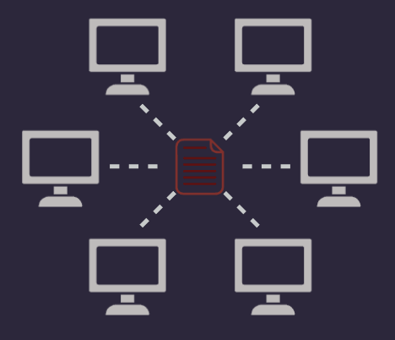







Nextflow
Custom Pipeline
Nextflow Pipeline
Use Case Studies - Reentrancy
Notes:
In our next use-case Susan has settled in to her role with the research group and now wants to start correcting some of Markus's malpractices. She decides that it’s time to create a pipeline that is reproducible so that if she leaves, or wants to revisit the analysis at a later date, no matter the case, the user will be able to reproduce her results. (click through) . Now that it’s constructed, she starts processing some sequencing samples through the pipeline, but she ends realizing she made a typo in the parameter file (whoops, we are all human, everyone is capable of making mistakes). She ended up using the wrong reference genome to align her sequencing reads to (it’s okay susan I myself have made this mistake before). Unfortunately, the pipeline output is pretty much useless, and the intermediate files are not organized in any sort of functional manner (this is a real problem that people within these given roles often face as they are trying to toggle and orchestrate analyses such as these “show eager”. It’s almost impossible to re-calibrate after an error that has such high network centrality within your analysis. Custom pipelining aims to tackle the reproducibility of these problems, but you can still be burned by user-error and end up having to absorb lost resources, effort, and time from a failed run.
The way Susan can overcome this issue is by using a language like Nextflow to manage her pipelines order and function, and also track the progress of any given run through the pipeline. Through the use of what nextflow calls a run’s work directory, we can store all intermediate inputs and outputs of the pipeline and index them by the tool or program used to create or use them. This indexing, which is really just a history of your most previous run, can then be used if the user or Susan in this case wants to change something about the run and then resume. Nexrflow allows it’s users to cache or remember any progress made by the last run, that was untouched or unaffected by the most recent changes. This pillar also upholds data safety principles that we discussed with reproducibility. For example, its Friday and you make some progress on a run using a set of programs but you hit a failure point at say… 4:30… it’s likely you aren’t going to want to try and find the source of said error until Monday. So you hang, it up for the weekend, but some developers of a program you were using in the run decide they are gonna be the weekend warriors and update their program which changes it’s functionality on Saturday night. You blindly stumble back in on Monday and resume your run, and if you weren’t completely plugged in on the updates of programs in your pipeline over the weekend, you would miss the fact that one of your programs is now operating slightly different affecting your results. However, nextflow even has fail-safes built in for that super extreme-not-very-likely scenario, where that process using the updated tool will have to be re-run in order for the workflow to complete.

Slide 14

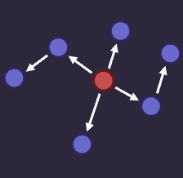






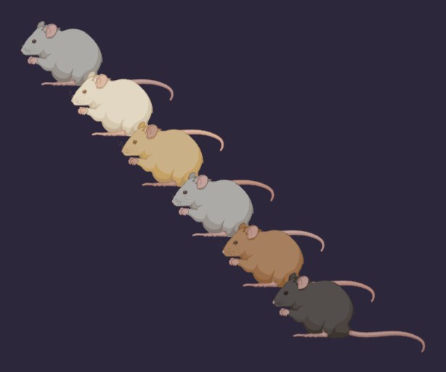
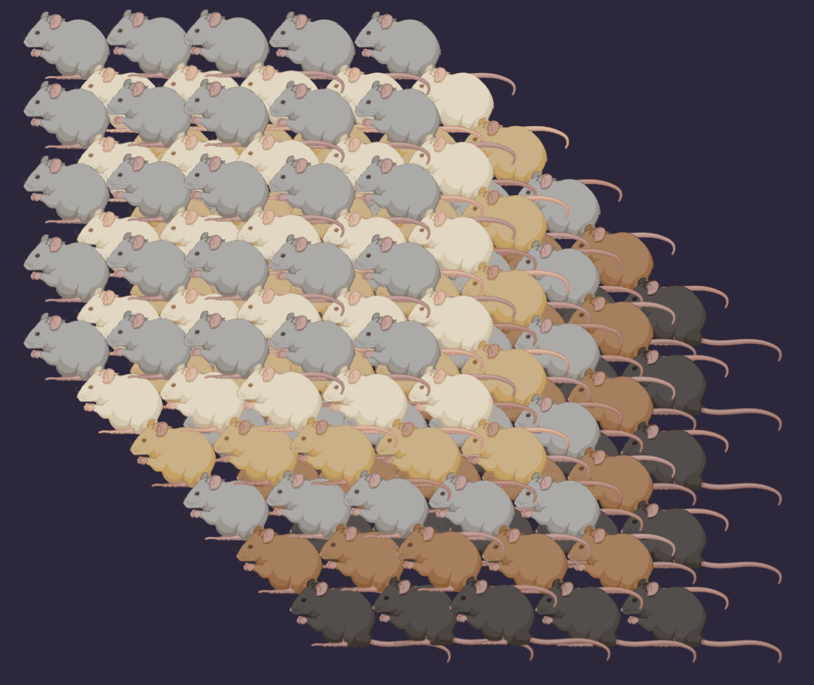
Nextflow
Use Case Studies - Parallelism
Notes:
Ashley and the group had another project come across their plate, but didn’t have enough resources or workers to delegate the project internally. So they decided to hire a third-party group to handle the analysis. Just so happens, that is the company that Markus had left them for (kinda awkward.). The group had conducted a seq study on 6 different mouse models and used that preliminary data to apply for a grant. The grant review board gave them their feedback and really doc’d them a lot of points for underwhelming statistical significance in their discovery. So… Ashley decided to handle that problem, which…. posed a tall task for Markus and his new company to address.
He begins processing mouse the data sample-by-sample using his companies SOP’s and programs to handle the data. A month later he finishes the project and sends Ashley’s lab a bill for x amount of dollars (I’m sure some of you can fill in the blanks from experience) which uses way more of their total operating bill for the project than they originally intended.
However, if the group had outsourced their analysis to company devoted to utilizing nextflow pipelines, they would have been able to complete the processing in 1/n samples the time (and probably cost). This is achieved by nextflow allowing for the orchestration of it’s pipelines via batch schedulers. This means that each process that gets initiated throughout the pipeline gets its own compute environment with isolated resources to conduct the job irrespective of any other job or program being run.
The technical components that nextflow uses to achieve such a feature are data structures known as channels, process’s, and workflows which run a given program defined by the developer.

Slide 15
Nextflow
A reactive workflow framework and a programming DSL
Processes
Channels
Workflow

Slide 16

Nextflow
A reactive workflow framework and a programming DSL
Process
Task 1
data x
output x
Input Channel
Task 2
Output Channel
data x
data y
data z
data y
output y
output x
output y
output z
Task 3
data z
output z

Slide 17
Nextflow
A reactive workflow framework and a programming DSL
Process 1
Process 2
Tasks
Tasks
Process 3
Tasks

Slide 18
Nextflow
Managing modern workflows is easier with Nextflow

